Slide 1
CHAPTER 4
SOFTWARE PROJECT MANAGEMENT
PART -II

Slide 2
Course Learning Outcomes
CLO4: Identify and apply the principles, processes and main knowledge areas for Software Project Management.

Slide 3
Topics
Project Planning
  Scope Management (DO NOT DRIFT – SCOPE CREEP)
  Project Estimation (AVAIL RESOURCES (HR+MONEY+SCHEDULE)
  Risk Management (Known + Unknown)
  Communication plan (Customer+Stakeholder+Teams+Executives (BUY-IN))
Project Execution (DoR)
Project Control (Monitoring the Project)
Project Closing

Slide 5
GLOBAL SOFTWARE ENGINEERING
ATT BELL UNIX → 75 US $
XEROX ---> HQ (NEW YORK)
CALIFORNIA (PALO ALTO) ---
OS (Graphical) – MOUSE (=1980)

Slide 6
GLOBAL SOFTWARE ENGINEERING
XEROX ---> HQ (NEW YORK)
STEVE JOBS
CALIFORNIA (PALO ALTO) ---
OS (Graphical) – MOUSE (=1980)

Slide 7
Managing the Software Systems Project
Managing Projects is an important aspect of the software development and a critical skill for a software developer.
Focus of project management
    Quality product within budget and time to ensure that software system projects meet customer expectations (requirements)
3.<number>

Slide 8
Project Manager ?????
PLANS (SCHE, COST, HR, RISK, COMMs, etc….)
Programmer XX SAR/hour
MICROSOFT/STC/ARAMCO
PM != PO
PM = PO (SMALL & STARTUPS
PM Yuksel …….. (BUS STATIONS)

Slide 9
Idea
PoC: Proof of Concept
Mr. Ahmed
Mr. Khaled
BUSINESS PLAN
MARKET STUDY
IP PORTFOLIO
MARKET VALUE
COMPETITORS
500 PAGES
300 HOURS
Venture Capital ($$$$)

Slide 10
2 LANGUAGES
2 SCRIPTING LANG
1 DB SYSTEM
Software development projects are undertaken for three reasons
  To take advantage of business opportunities by providing an innovative service to the customer
  To solve business problems, by modifying the existing system so that more accurate or timely information is provided to the users.
  To follow a directive from the management or Government or a potential customer.

Slide 11
Need of Software Project Management
Software is said to be an intangible product. The most important is that the software technology changes and advances so frequently and rapidly that experience of one product may not be applied to the other one. All such business and environmental constraints bring risk in software development hence it is essential to manage software projects efficiently.

Slide 12
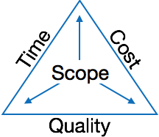
Triple Constraints for Software Projects
It is an essential part of software organization to deliver quality product, keeping the cost within client’s budget constraint and deliver the project as per scheduled. There are several factors, both internal and external, which may impact this triple constraint triangle. Any of three factor can severely impact the other two.
Therefore, software project management is essential to incorporate user requirements along with budget and time constraints.

Slide 13
101010101010111010101010101010101010101010101010101010101010101010101010101010

Slide 14
101010101010111010101010101010101010101010101010101010101010101010101010101010

Slide 15
Managing the Software Systems Project
Product Owner??
Project Manager (PM) is responsible for all aspects of a software development.
PM experiences an environment of continual change and problem solving.
In order to implement successful projects, a PM is required to manage
  resources and
  tasks needed to complete the software projects.
3.<number>

Slide 16
PLAN OF THE WORK
WORK THE PLAN

Slide 17
20% 40 MILLIONS US $
10⁶ Barrels/day
5 Millions

Slide 18
4- What is Project Management?
Project Management = Plan the work and work the plan
Management Functions
Planning: Estimate and schedule resources
Organization: Who does what
Staffing: Recruiting and motivating personnel
Directing: Ensure team acts as a whole
Monitoring (Controlling): Detect plan deviations + corrective actions

Slide 19
Software Project Management Activities
  Software project management comprises of a number of activities.
Project Planning
  Scope Management
  Project Estimation
  Risk Management
  Communication plan
Project Execution
Project Control (Monitoring the Project)
Project Closing

Slide 20
Project Planning
Software project planning is task, which is performed before the production of software actually starts.
It is there for the software production but involves no concrete activity that has any direct connection with software production; rather it is a set of multiple processes, which facilitates software production.

Slide 21
Scope Management
It defines the scope of project; this includes all the activities, process need to be done in order to make a deliverable software product.
Scope management is essential because it creates boundaries of the project by clearly defining what would be done in the project and what would not be done.
This makes project to contain limited and quantifiable tasks, which can easily be documented and in turn avoids cost and time overrun.
During Project Scope management, it is necessary to -
  Define the scope
  Verify the scope
  Divide the project into various smaller parts for ease of management.
  Control the scope by incorporating changes to the scope

Slide 22
Project Estimation
For an effective management accurate estimation of various measures is a must.
With correct estimation managers can manage and control the project more efficiently and effectively.
Project estimation may involve the following:
Software size estimation
Effort/Resource estimation
Time estimation/Project Scheduling
Cost estimation

Slide 23
EFFORT ESTIMATION
# HOURS -→ PROGRAMMER $$$/HOUR
# LINES OF CODE
CODER # 1 DR. JEFF DEAN $$$$/HOUR????

Slide 24
Project Estimation- Cost
Create a preliminary budget that outlines the planned expenses and revenues associated with your project.
Justify that the benefits which we get from the project will be more than the cost spent in developing it. Use NPV cost benefit analysis.

Slide 25
Project Estimation- Resources
The goal of this activity is to estimate resource requirements for each project activity and use this information to create a project resource plan.
The resource plan helps assemble and organize resources in the most effective manner.

Slide 26
Different types of Resources
People – inclusive of all the system owners, users, analyst, designers, builders, external agents and clerical help involved in the project. Most important resource.
Facilities and equipment – inclusive of all rooms and technology that will be needed to complete the project.
Supplies and material – everything from pencils, paper, notebooks, toner cartridges etc.
Services – a service such as quality review.
Money – which is used o develop the project.

Slide 27
Different types of Resources
Example : People are the most important and expensive part of project resource planning.
The completion of the project and overall system quality depends on the tasks assigned to people.
Assign tasks to resources in such a way so that they can learn new skills and at the same time the work is well suited to their skills.

Slide 28
Project Estimation - Scheduling
Project Scheduling in a project refers to roadmap of all activities to be done with specified order and within time slot allotted to each activity.
Project managers tend to define various tasks, and project milestones and arrange them keeping various factors in mind.
For scheduling a project, it is necessary to -
Break down the project tasks into smaller, manageable form
Logically order them to ensure smooth evolution between tasks. The hierarchical decomposition of project into phases, activities, and tasks and their sequences is called “work breakdown structure (WBS)”.Some tasks are performed in parallel whereas others follow one another sequentially

Slide 29
Task 1
Task 2
Requirements
Design
Task N
Task N
Term Report
Editing

Slide 30
Task # | Start Date | End Date
Task 1
Task 2
Task 3
Predecessor | Successor | Cost
HR | Material | Priority
2 Programmers + 1 Progra
2000

Slide 31
Project Estimation - Scheduling
The WBS consists of
Summary tasks : is one that consists of other tasks such as phases and activities.
Primitive tasks : is one that does not consist of any other tasks.
Deliverables are work products that are delivered to the customer, e.g. a requirements document for the system. A deliverable may be composed of multiple smaller deliverables. It may be either an outcome to be achieved or a product to be provided.

Slide 32
In WBS , the Milestones are events that signify the accomplishment or completion of major deliverables during a project. e.g. producing requirement statement.
Milestones are points in the schedule against which you can assess progress, for example, the handover of the system for testing.
Project Estimation - Scheduling (Deliverables and Milestones)

Slide 33
Project Goal
0
Task Definition:
LEVEL 1 (or 0)
Summary tasks
Phase
Phase
Phase
2
3
1
activity
activity
activity
2.3
2.1
2.2
Primitive task
task
task
2.2.2
task
2.2.3
2.2.1

Slide 34
Task Definition:
LEVEL 2 (or 1)
Phase 1
Task 1
Task 2
Task N

Slide 35
Task Definition:
LEVEL 3 (or 2)
Task 1
Task 1.1
Task 1.2
Task 1.M

Slide 36
Work Breakdown Schedule -→ CLIENT STANDARDS
EXAMPLE: US DoD
https://www.secnav.navy.mil/rda/OneSource/Documents/New%20MIL-STD-881C%20Work%20Breakdown%20Structures%20for%20Defense%20Materiel%20Items.pdf

Slide 37
CAR PRODUCTION LINE
Phase 1
Build Car Chassis
Phase 2
Build Car Engine
Task 2.1
Build Gear Box
Task 1.1
Paint Car Chassis
Task 2.2
Build Break System
Task 1.2
Assemble Chassis Parts

Slide 38
Phase 1
Task 1.1
Task 1.2
Task 1.3
Phase 2
25 Persons
Fix 4 Tires
1 Person

Slide 39
Project Estimation - Scheduling
Estimate time frame required for each task
Divide time into work-units
Assign adequate number of work-units for each task
Assign resources to each task.
Calculate total time required for the project from start to finish

Slide 40
Project Estimation - Scheduling
They look for tasks lie in critical path in the schedule, which are necessary to complete in specific manner (because of task interdependency) and strictly within the time allocated.
Arrangement of tasks which lies out of critical path are less likely to impact over all schedule of the project.

Slide 41
Project Estimation - Scheduling
The tasks sequence depends on
  which tasks produce deliverables needed in other tasks,
  when critical resources are available,
  the constraints placed on the project by the client, and
  the process outlined to the SDLC.

Slide 42
Example: Project Scheduling
1. Identifying the activities
  Define Requirements
  Screen design
  Report design
  Database construction
  User documentation creation
  Software programming
  System testing
  System Installation

Slide 43
Suppose I need to collect system requirements by interviewing users of the new system and reviewing reports they currently use to do their job. I divide the project into manageable tasks as follows:
1. Define Requirements
1.1 Interviewing
1.1.1 Design Interview forms (2 days – TSP (5 forms / day)
1.1.2 Schedule Appointments
1.1.3 Conduct interview
1.2 Review current reports
1.2.1 Collect reports
1.2.2 Review Reports
1.2.3 Summarize results
Example: Project Scheduling

Slide 44
CAR TESTING
From each 1000 cars pick randomly 10 cars and take for a ride
COMMERCIAL AIRCRAFT TESTING
Test each aircraft for 100 hours flights

Slide 45
SAFETY TEST
EVACUATE 650 PASSENGERS IN LESS THAN 60 SECONDS!
IATA

Slide 46
Project Scheduling- Estimating task duration
Using information on tasks & on the availability of resources, assign (estimate) duration to each primitive tasks in the work breakdown structure. The task duration for all summary tasks is calculated automatically based on the estimated durations of their component primitive tasks.
Allocating duration to each tasks helps us to create target starting and ending dates for the project.
Target dates should be acceptable to the customer.
Notes:
Duration of any task is a random variable, subject to factors such as the size of the team, number of users, availability of users, aptitude of users, complexity of the business system, information technology used, experience of team personnel, time committed to other projects and experience with other projects.

Slide 47
Project Scheduling- Estimating task duration
When estimating task duration, it is important to understand the concept of elapsed time.
Elapsed time takes into consideration two important people factors.
  Efficiency: No worker performs at 100% efficiency. Most people take coffee breaks, lunch breaks, restroom breaks and time to read their e-mail, check their calendars, participate in their non project work and even engage in idle conversation. It has been calculated that the average worker is 75% productive.
  Interruptions : People experience phone calls, visitors and other unplanned interruptions that increase the time required for project work. This is variable for different workers. Interruptions can consume as little as 10 % of your day or as much as 50 %.

Slide 48
Mr. A: I read the WHOLE book in 10 hours (during 10 years!)!
Mr. B: I read the WHOLE book in 5 hours (during 10 hours)!
Mr. C: I read the WHOLE book in 3 hours (during 4 hours)!

Slide 49
Project Scheduling- Estimating task duration)
Estimate the minimum amount of time it would take to perform the task. This is called optimistic duration (OD). The optimistic duration assumes that event the most likely interruptions or delays such as occasional employee illnesses, will not happen.
Estimate the maximum amount of time it would take to perform the task. This is called pessimistic duration (PD).The pessimistic duration assumes that nearly anything that can go wrong will go wrong. All possible interruptions or delays such as labor strikes, illnesses, training, inaccurate specifications of requirements, equipment delivery delays and under estimation of the systems complexity are assumed to be un avoidable.

Slide 50
Project Scheduling- Estimating task duration
Estimate the Most Likely Duration (LD) that will be needed to perform the task. Identify interruptions or delays that are most likely to occur such as occasional employee illness, inexperienced personnel and occasional training.
Calculate the Expected Duration (D) a follows:
D= (1 x OD) + (4 x LD) + (1 x PD)
    6
    Where 1, , 4, 1 are default weights.
    Because the completion time should be closest to the most likely time (LD), it is weighted 4 times than the OD and PD.

Slide 51
D = (0.2 x 6) + (0.4 x 12) + (0.2 x 2)
Wall Painting (PSP):
10 hours → 50m² / hour
1/6
4/6
1/6
Concrete Laying foundation (TSP):
3 days → 100m² / day

Slide 52
Project Scheduling- Estimating task duration
ACTIVITY | TIME ESTIMATE OD LD PD | EXPECTED TIME
1. REQUIREMENT COLLECTION | 1 5 9 | 5
2. SCREEN Design | 5 6 7 | 6
3. Report Design | 3 6 9 | 6
4. Database design | 1 2 3 | 2
5. User Documentation | 3 6 7 | 5.5
6. Programming | 4 5 6 | 5
7. Testing | 1 3 5 | 3
8. Installation | 1 1 1 | 1

Slide 53
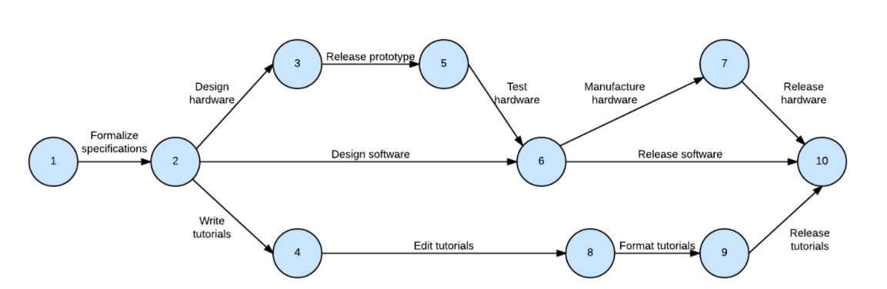
Project Scheduling- Estimating task duration
Determine the sequence of the activities and precedence relationships among all activities
Determine the order in which activities should take place which will help you to understand how the activities are related by constructing PERT (Program Evaluation and Review Technique) chart.
PERT charts: Utilized before a project begins to plan and determine the duration of each task
PERT Chart

Slide 54
PERT Chart

Slide 55
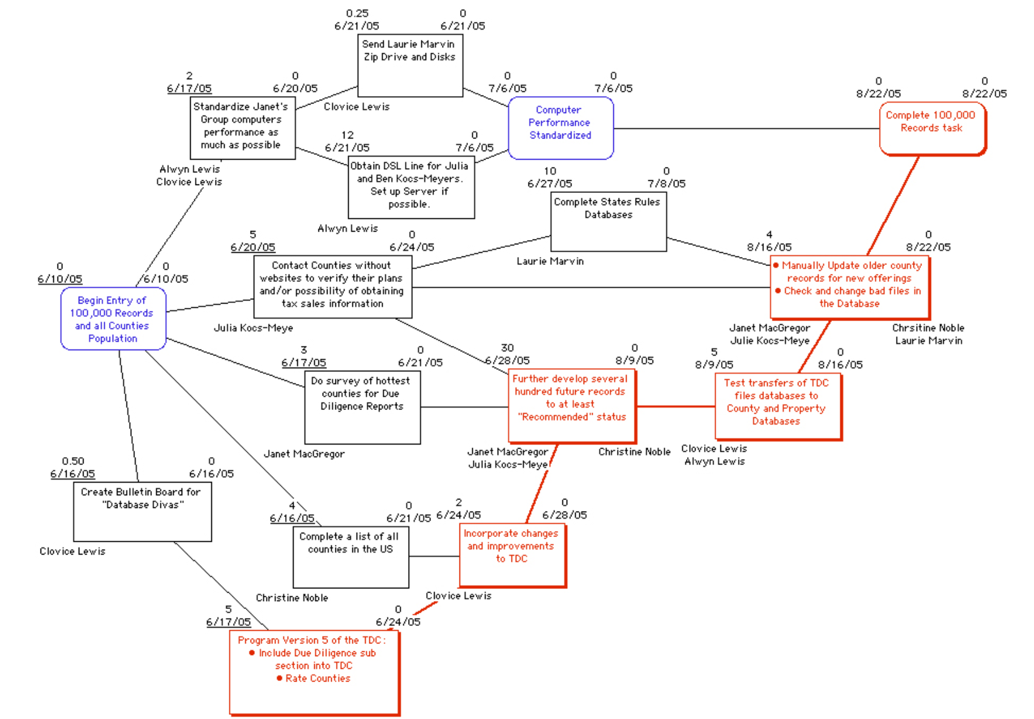
PERT Chart : Complex View

Slide 56
Project Estimation - Scheduling
Determine the critical path
The critical path on a PERT network is represented by the sequence of connected activities that produces the longest overall time period. In other words, the minimum time required to finish the project can be estimated by considering the longest path in the activity graph (the the critical path).
All nodes and activities within this sequence are referred to as being “on” the critical path.
Any activity on the critical path if delayed in completion delays the entire project.
Nodes not on critical path however can be delayed without delaying the final completion of the project.
Nodes not on the critical path contain slack time and allows the project manager some flexibility in scheduling.

Slide 57
Project Estimation - Scheduling Critical path Analysis
A forward pass determines the Early Finish Time (EF), which is the earliest possible time an activity can finish based on the network logic.
The project start date is equal to the early start date for the first network diagram activity. Early start plus the duration of the first activity is equal to the early finish date of the first activity. It is also equal to the early start date of each subsequent activity.
When an activity has multiple predecessors, its early start date is the latest date which occurs later of the early finish dates of those of predecessors.

Slide 58
Project Estimation - Scheduling Critical path Analysis
A backward pass through the network diagram determines the latest Finish time for each activity, which is the latest possible time an activity can be completed without delaying the project finish date.
Slack time for each activity is equal to the difference between its latest and earliest expected completion times ( i.e. ST=LF- EF)
Slack time is zero for an activity on the critical path.

Slide 59
Project Estimation - Scheduling Critical path Analysis
When an activity has multiple successors, its latest finish date is the earliest (minimum) which occurs early of the latest finish dates of those of successors.

Slide 60
Project Estimation - Scheduling Representing and Scheduling Project Plans
Gantt Charts
  Useful for depicting simple projects or parts of large projects
  Show start and completion dates for individual tasks
PERT Charts
  Show order of activities
3.<number>

Slide 61
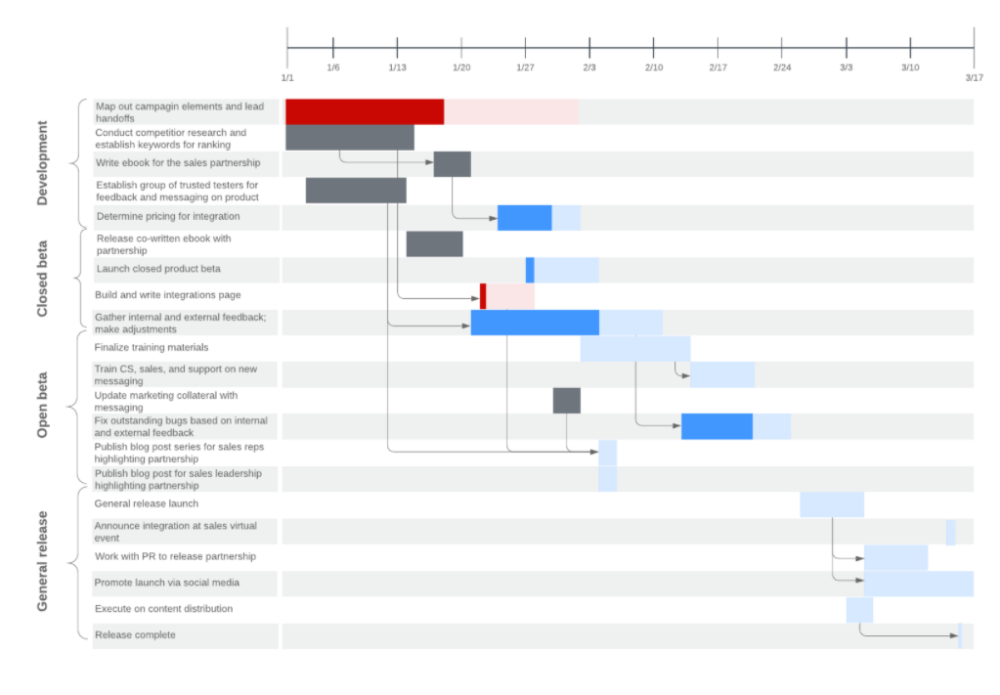
Gantt Chart

Slide 62
Comparison of Gantt and PERT Charts
PERT
  Visually shows dependencies between tasks
  Visually shows which tasks can be done in parallel
  Shows slack time by data in rectangles
Gantt
  Visually shows duration of tasks
  Visually shows time overlap between tasks
  Visually shows slack time
Created by Henry Gantt during the first world war (WWI)!!!
The U.S. Navy created this tool in the 1950s as they developed the Polaris missile!!!
3.<number>

